Slide 1
Speed Limit Sign Detection & Recognition
Literature Review

Slide 2
Academic Literature

Slide 3
Academic Literature
Our project focuses on employing computer vision and machine techniques to detect speed limit and read the limits
Main issue - Many researchers used a European traffic sign dataset to build their programs
Scholars creating traffic sign recognition systems (TSR) that focus on differentiating the various signs
Few of them take it a step further by identifying the numbers on the speed limit signs.
Looking at academic literature helped us find out dataset
Researchers employed a variety of computer vision techniques, including edge detection using Hough transform to detect rectangles, Integral &amp; Aggregate Channel features, Fast Radial Symmetry (FRS), thresholding for determining the actual speed limit values, etc.

Slide 4
Academic Literature
Due to speed limit signs being monochrome with a white background, it’s hard to detect them with color-based approaches and produces mixed results
Most commonly used traffic sign detector created to date is the Fast Radial Symmetry detector
A voting-based detector that works directly on the edges of an image that can be extended to find rectangles
Some researchers used computer vision-based detection techniques for detecting the signs and then used modeling techniques such as neural networks and SVM to create the recognition algorithm that reads the text on the signs
Based on the research:
Use a shape/ edge-based detection algorithm to detect the speed limit signs
Create a neural network (using TensorFlow or scikit-learn) OR machine learning algorithm (SVM) to train the model to determine the limit values

Slide 5
Publicly Available Data Tools, & Code

Slide 6
Programming Language - Python
An interpreted high-level programming language for general-purpose programming
Created by Guido van Rossum and first released in 1991
Design philosophy that emphasizes code readability, and a syntax that allows programmers to express concepts in fewer lines of code, notably using significant white space
features a dynamic type system and automatic memory management
supports multiple programming paradigms, including object-oriented, imperative, functional and procedural, and has large and comprehensive standard libraries
has many image intensive libraries like Python Imaging Library, VTK and Maya 3D Visualization Toolkits, Numeric Python, Scientific Python and many other tools available for numeric and scientific applications

Slide 7
Data
LISA Traffic Sign Dataset
http://cvrr.ucsd.edu/LISA/lisa-traffic-sign-dataset.html
Contains a set of videos and annotated frames containing US traffic signs
Each sign is annotated with sign type, position, size, occluded (yes/no), on side road (yes/no), all of which are in plain text .csv files
Additionally, it includes a set of Python tools to handle the annotations and easily extract relevant signs from the dataset

Slide 8
Code
https://towardsdatascience.com/recognizing-traffic-signs-with-over-98-accuracy-using-deep-learning-86737aedc2ab
https://medium.com/@waleedka/traffic-sign-recognition-with-tensorflow-629dffc391a6
https://universalflowuniversity.com/Books/Computer%20Programming/Computer%20Vision%20and%20Image%20Processing/OpenCV%20with%20Python%20Blueprints_%20Design%20and%20develop%20advanced%20computer%20vision%20projects%20using%20OpenCV%20with%20Python.pdf
https://github.com/topics/traffic-sign-recognition

Slide 9
Industry Solutions

Slide 10
Tesla
In 2017, with version 8.0 of its software, Tesla employs a video camera, image-processing software, and radar that uses a crowdsourcing system called “fleet learning” to navigate driving on the highway
Before update, radar wasn’t used as part of the primary system for autopiloting
HARDWARE
8 surround cameras providing 360 degrees of visibility around the car at up to 250 meters of range
12 updated ultrasonic sensors complement the vision, allowing for detection of both hard and soft objects at nearly twice the distance of the prior system
Forward-facing radar with enhanced processing provides additional data about the world on a redundant wavelength that is able to see through heavy rain, fog, dust and even the car ahead
Onboard computer runs a Tesla-developed neural net for vision, sonar and radar processing software
provides a view of the world that a driver alone cannot access, seeing in every direction simultaneously, and on wavelengths that go far beyond the human senses

Slide 11
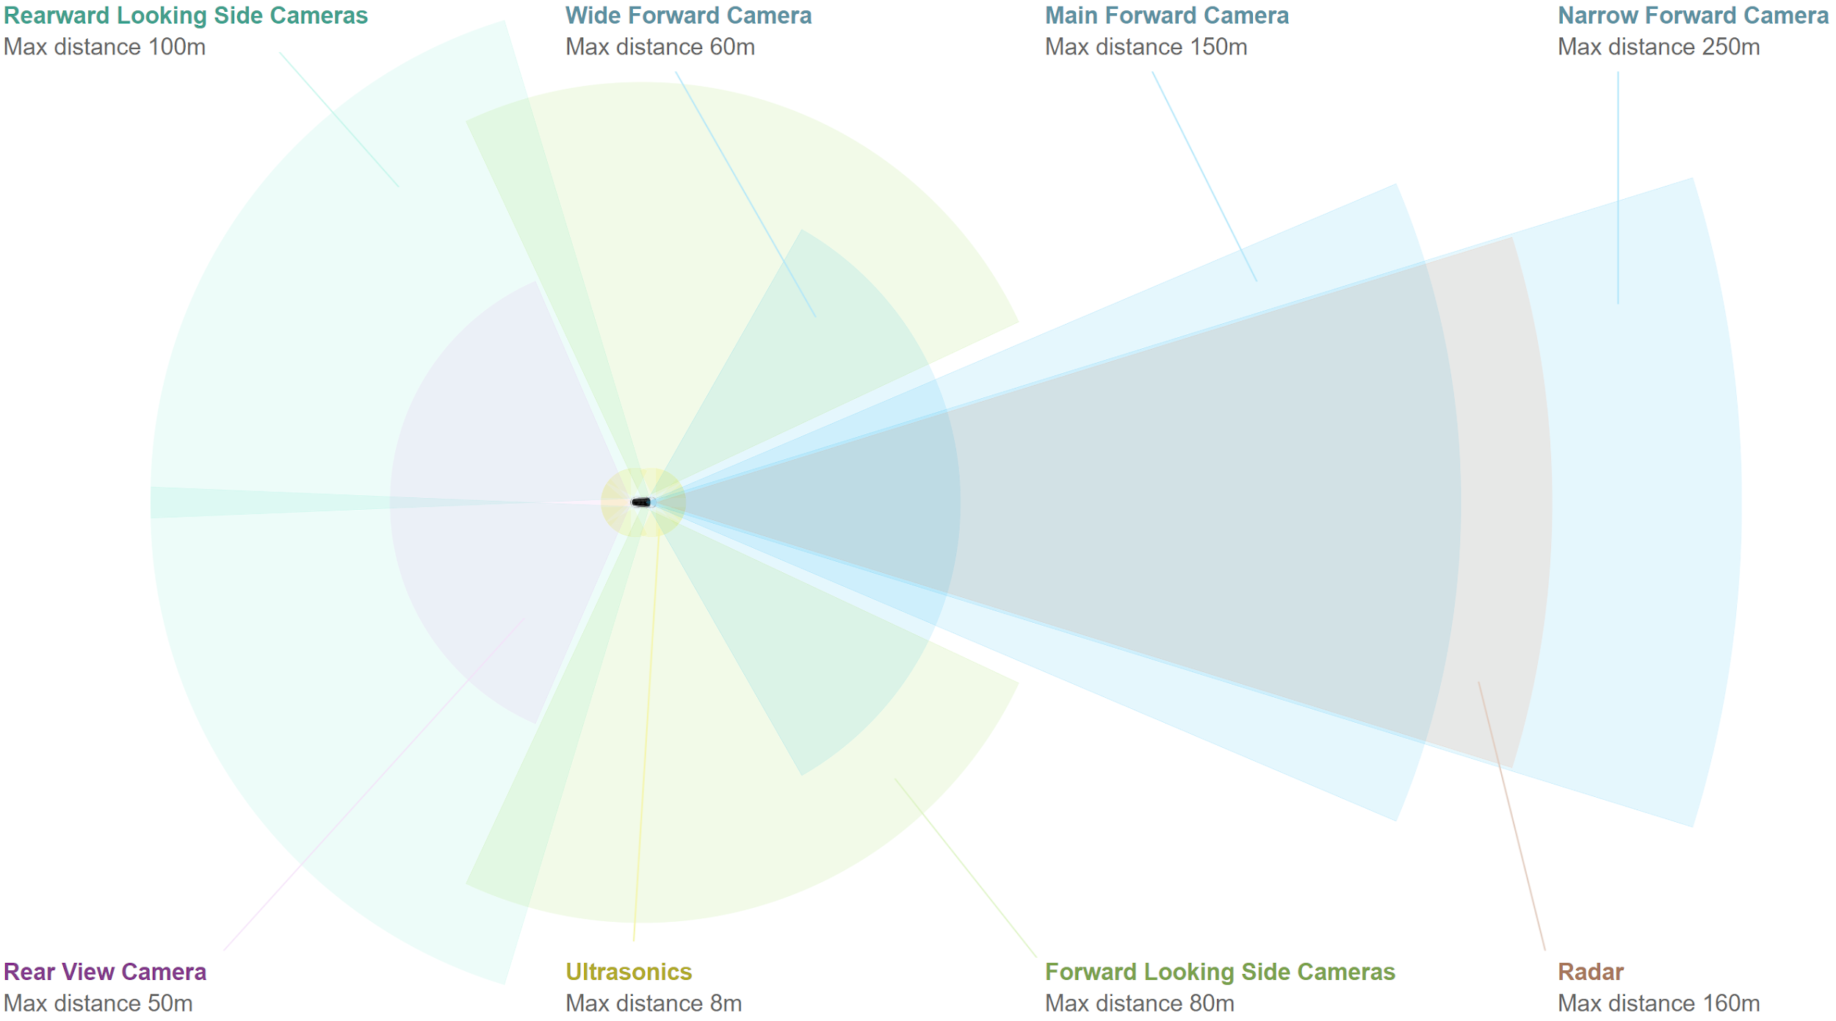
Tesla - Camera System

Slide 12
Nvidia
provides hardware and data solutions to suppliers and automobile manufacturers for implementing computer vision into their vehicles
DRIVE AGX - a scalable, open autonomous vehicle computing platform that serves as the brain for autonomous vehicles
DRIVE software enables key self-driving functionalities such as sensor fusion and perception
Open full-stack solution for developing applications for autonomous driving and user experience
Frameworks
Source Packages
Compilers
Libraries

Slide 13
Vaisala
RoadAI system that monitors signs and traffic with video recording
System goes through a video feed and detects a sign many times
Uses a video based, 3D point cloud system to localize all detection to a single position
filters out any incorrect detections using computer vision
RoadAI system is for those who need to monitor signs and traffic arrangements with a simple mobile video recording system
Combines the use of digital maps and smartphones

Slide 14
RISP
A company that focuses on image processing and computer vision
In the automotive field, they have created a traffic signs detections software
Software detects a road sign at a distance and using machine learning and two classifiers
It determines if it’s a speed limit sign
if it’s a speed limit sign, it determines what that limit is

